Slide 1



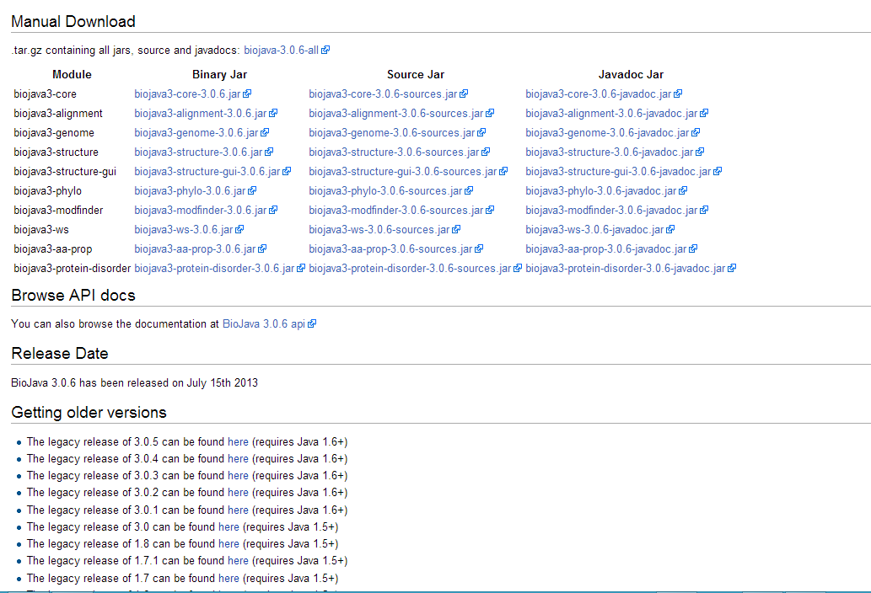
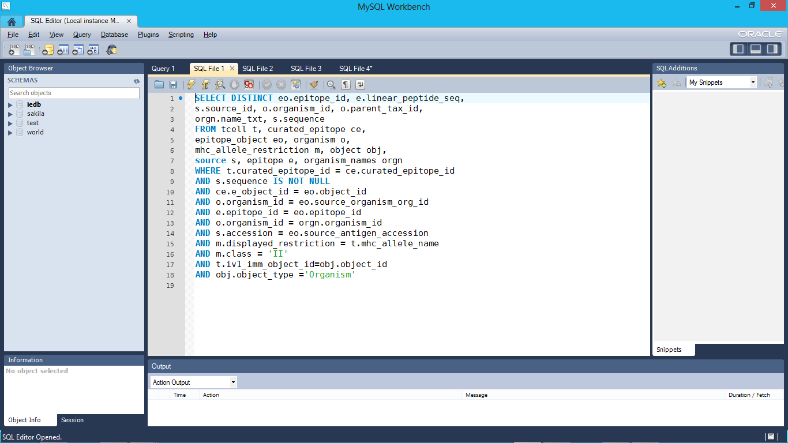
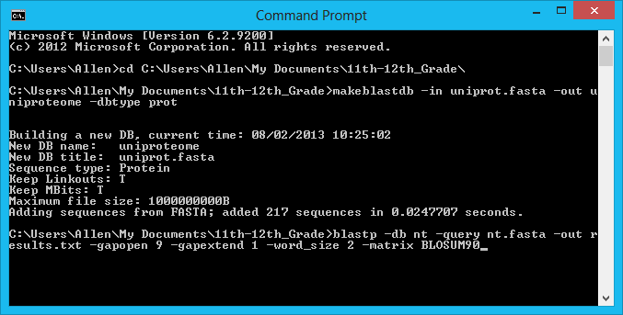
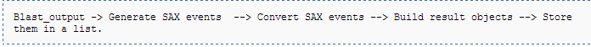
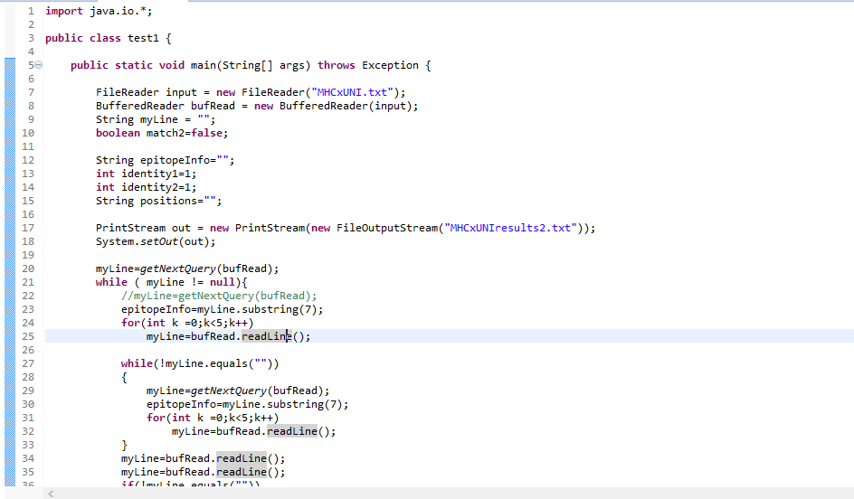


Study of Immune Epitopes: Java vs. Python
SDSC REHS 2013
STUDENT Allen Cao, La Jolla High School
MENTOR Dr. Julia Ponomarenko, NIH PI, SDSC
INTRODUCTION As the parts of antigens that our immune system recognizes, epitopes play a crucial role in the normal functioning of our body. Recognition and prediction of these epitopes is a vital part of medical innovation, and also paves the way for new scientific understanding of the human body works. The ultimate goal of this project is to find out if B-cell epitopes and CD4 T-cell epitopes have a tendency to be located in structurally disordered regions of proteins and conserved protein sequence regions, respectively. Viruses and bacteria evolve to escape the host immune system by making their proteins structurally disordered and mutating quickly. Both of these tendencies, if actually proven significant, could aid in improved logic of epitope predictors. Programmatic access to many programs proved to be an essential part of this project, and one option for a coding language was Java. This whole project proved difficult to implement in Java, which is why we decided to use Python for many aspects, as indicated by this poster.
BIOJAVA
There are discrepancies between versions of Biojava and Eclipse, and conflicting tutorials for each version on the official website. Biopython, in contrast, is a simple installation package.
SQL
Using MySQL Workbench, a free SQL development tool, proved to be the easiest way to query IEDB and obtain wanted data. Databases can be queried from Java.
BLASTing SEQUENCES
Can be used either through URLAPI or downloaded and run through command line. Biopython also has a package NcbiblastpCommandLine. Running command line code (to make databases) is also considerably simpler in Python.
BLAST PARSER
Biojava needs Maven plug-ins and a proper installation for XML reading. A custom text parser works, but is hardly worth the effort. Biopython can easily parse xml or csv formats and grab the filter information.
IUPred OR DisProt, AND PREDICTORS
These are disorder prediction algorithms that can be downloaded or accessed programmatically through the web. In the future, these predictors will be evaluated to ascertain which one will be used, as each has good and bad points
SUMMARY
Python is more suited for small-scale projects, as it is a scripting language. Java, although faster and more robust, is a poorer fit for our needs. Python’s syntax also complements short, looping programs while Java’s syntax defines things more clearly but takes more space.
ACKNOWLEDGMENTS
Thank you LIAI for providing guidance. I want to also thank my mentor Julia Ponomarenko for an engaging and amazing few months. Additionally, I would like to thank Lilia M. Iakoucheva, Bjoern Peters, and Yohan Kim for providing information and lectures. Finally, I would like to thank Lynn Zhou, Nathan Ng, Eric Chen, and Anita Kulkarni for participating in this program with me and never quitting.

